Slide 1
Change Empty .NET application to MVC
Empty to Model View Component

Slide 2
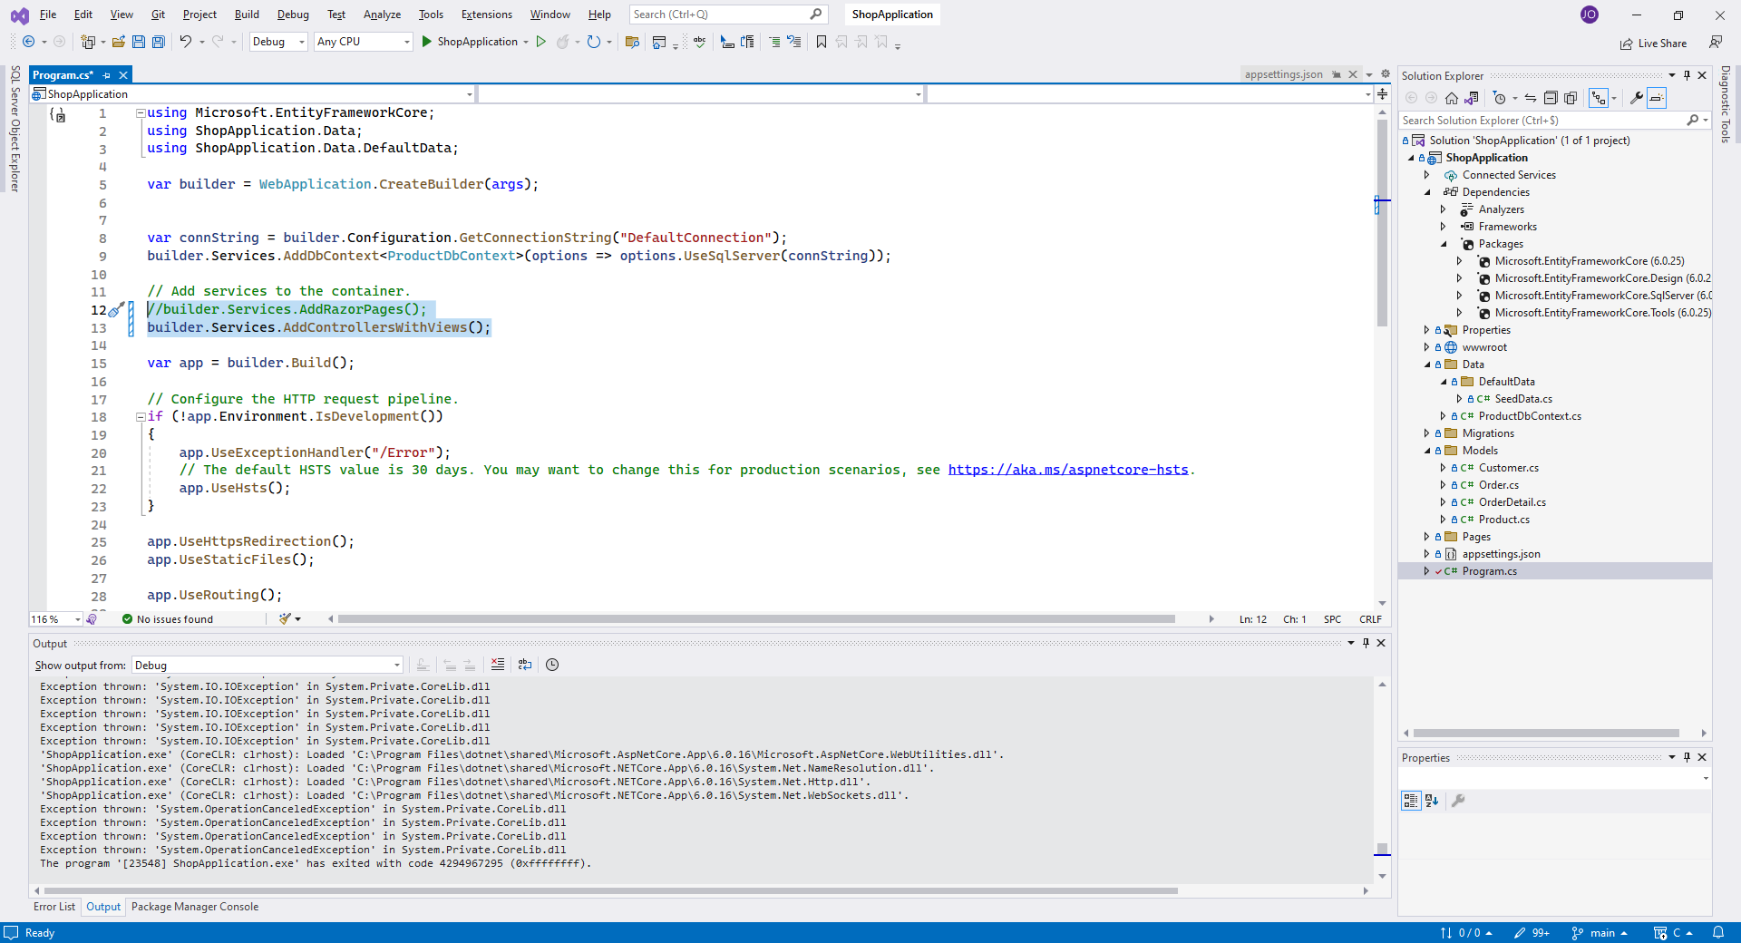
Program.cs
In Program.cs We Modify the services so we will use controllers with views. Telling the program we will work with MVC instead of Razor

Slide 3
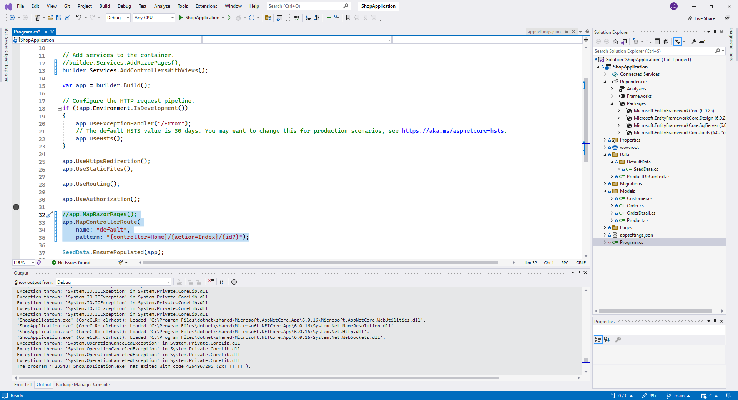
Program.cs
Still in Program.cs We modify the following code, since we don’t need to Start Razorpages, we will also not need to set the routing for it.So we set our custom routing as followed

Slide 4
Required folders
Then in our solution -> Project, We will remove the basic cshtml files in the Pages folder and add a folder named ‘Controllers’

Slide 5
Views
We add a folder named ‘Home’inside the Pages/View folder. This folder will be our Home page folder
We add a Razor Page in the Home folder

Slide 6
Views
We change the name from Pages to Views

Slide 7
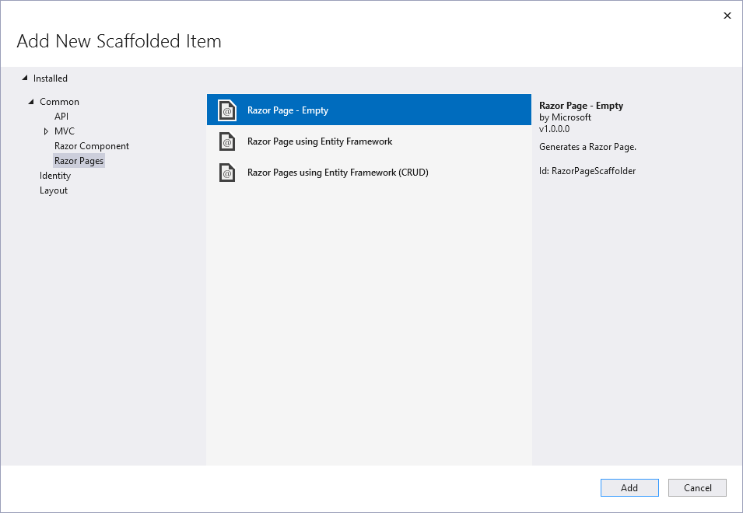
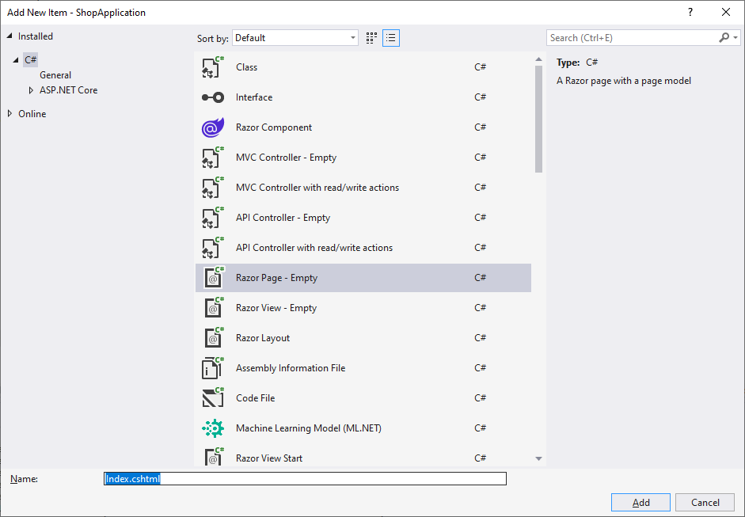
Views
For this example, we will add an Empty Razor Page
We will name this Page Index

Slide 8
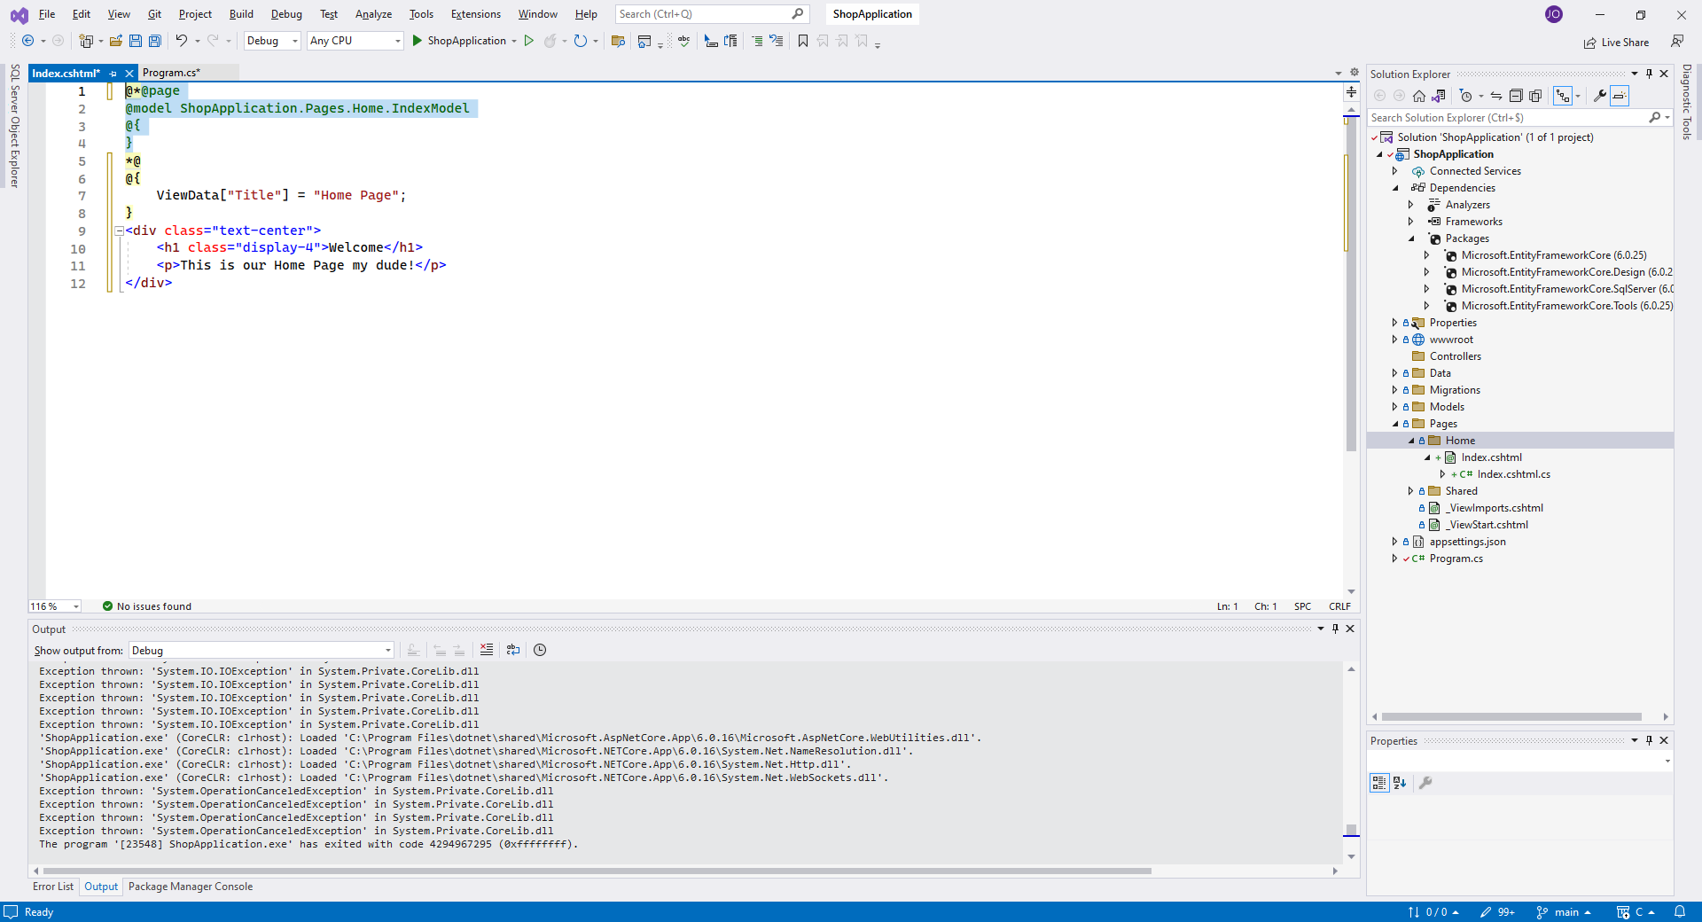
Views
We remove the default text and modify it like so
Everything between ‘@{ } above the project is where we place our C# code. If we bring in code or models, it happens here
Everything bellow it can be standard HTML/CSS/JS

Slide 9
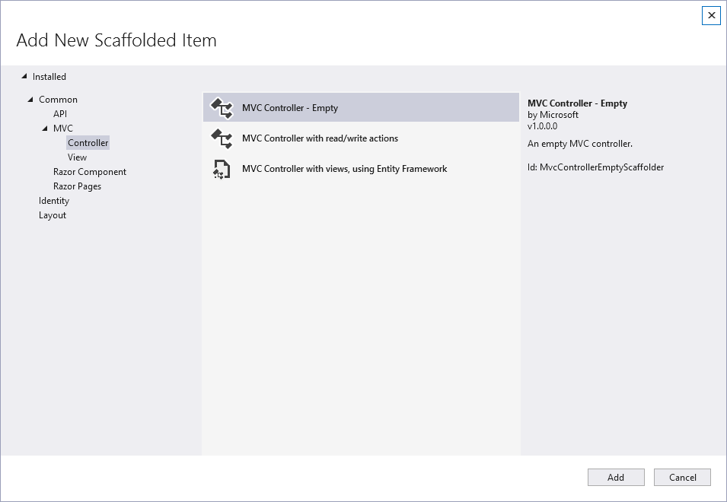
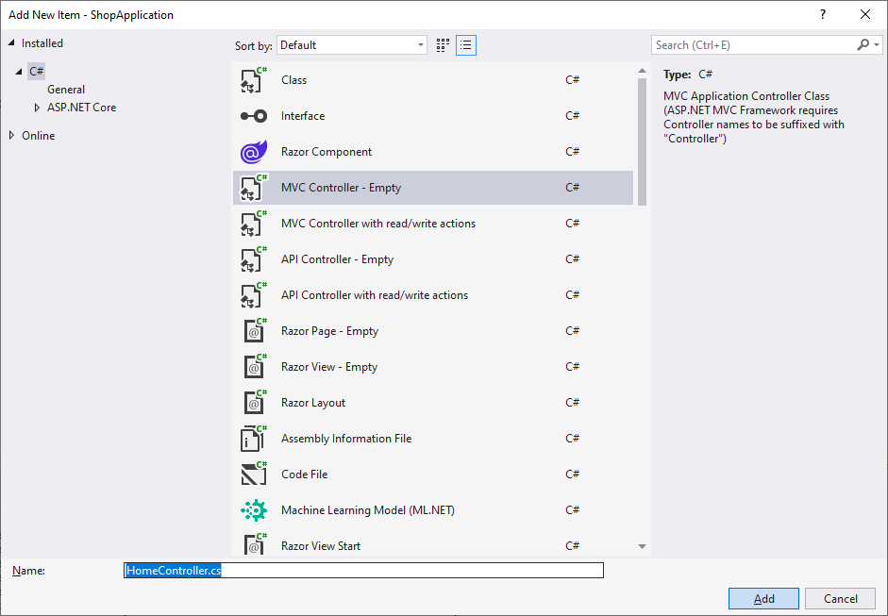
Controllers
Since we added one part of the Model View Controller, which is the View (Page) we will now add the Controller
In your Controllers folder we will now add… a controller !

Slide 10
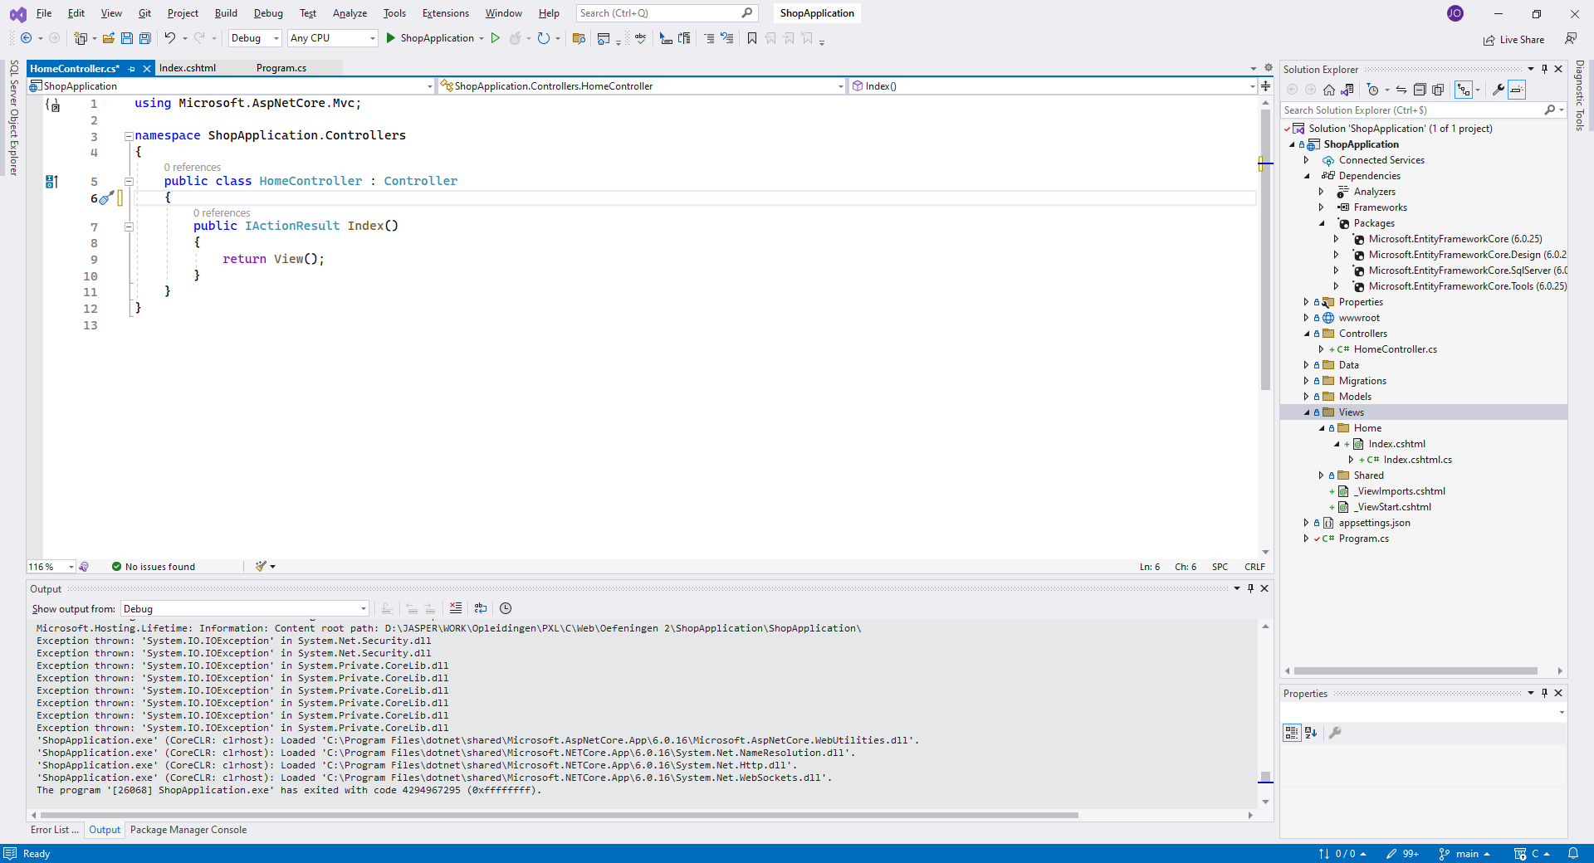
Controllers
In our empty Controller We only have the controller for Index

Slide 11
Views
In Views we add a new folder, this folder must have the name of which page you want to add. We want a Store navigation page now, so we add this inside Views

Slide 12
Views
In Views -> Store we add a new View

Slide 13
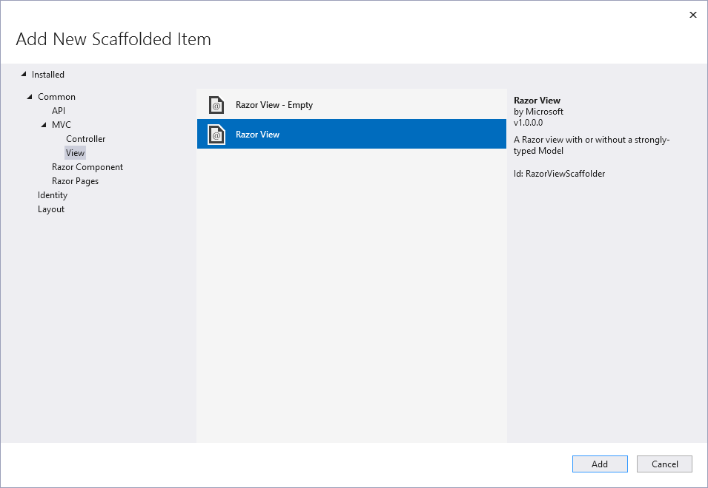
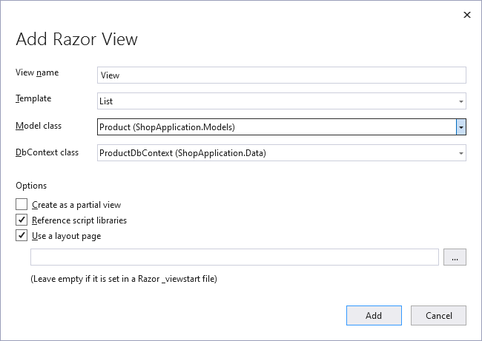
Views
This time we will not use the Empty
We name our View ‘View’
The template we use is List, here you can choose what the action is that you will be doing on this page
Since we will need to display products in our Store page we will choose ‘Product’ as our model.
Since we want our DB to be accessible we select ProductDbContext

Slide 14
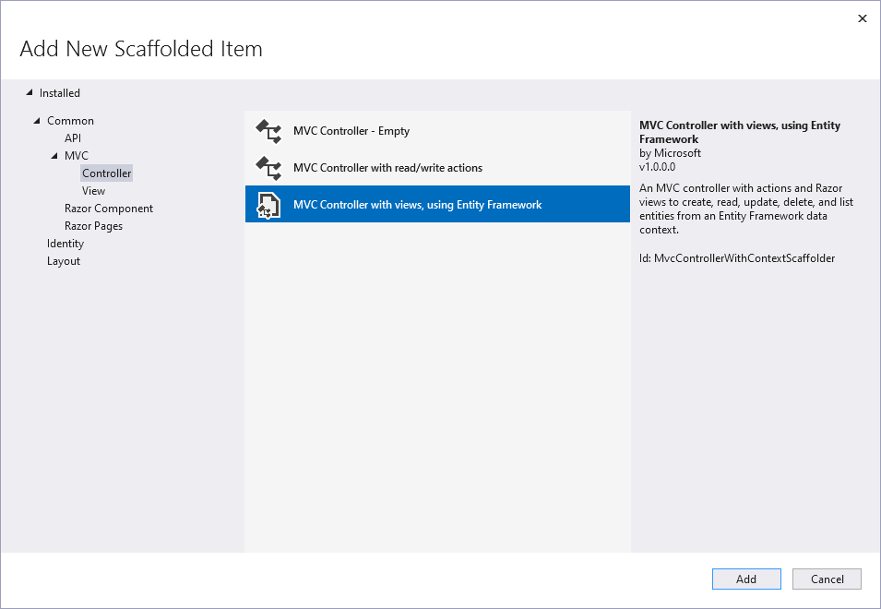
Controllers
For now we will leave everything as it is and add a controller for Shop
We select our model ‘Product’ and leave the rest as default
We then rename the controller to match the View we want to display. We want to use the ‘Store’ view so we rename this the ‘StoreController’

Slide 15
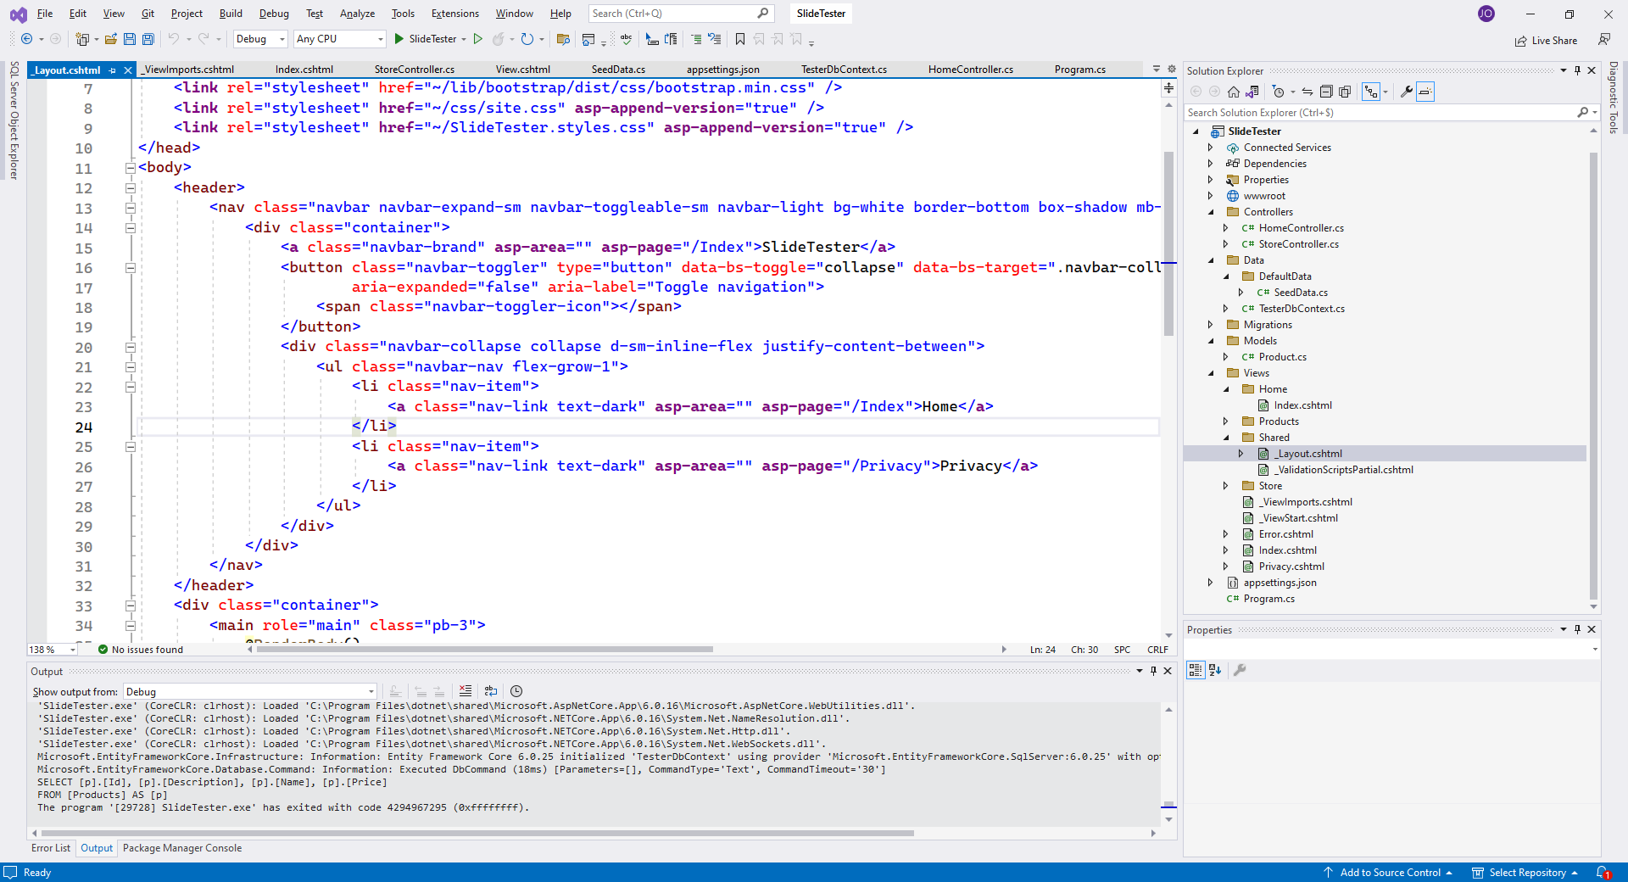
Shared
We navigate to Views -> Shared -> _Layout.cshtml

Slide 16
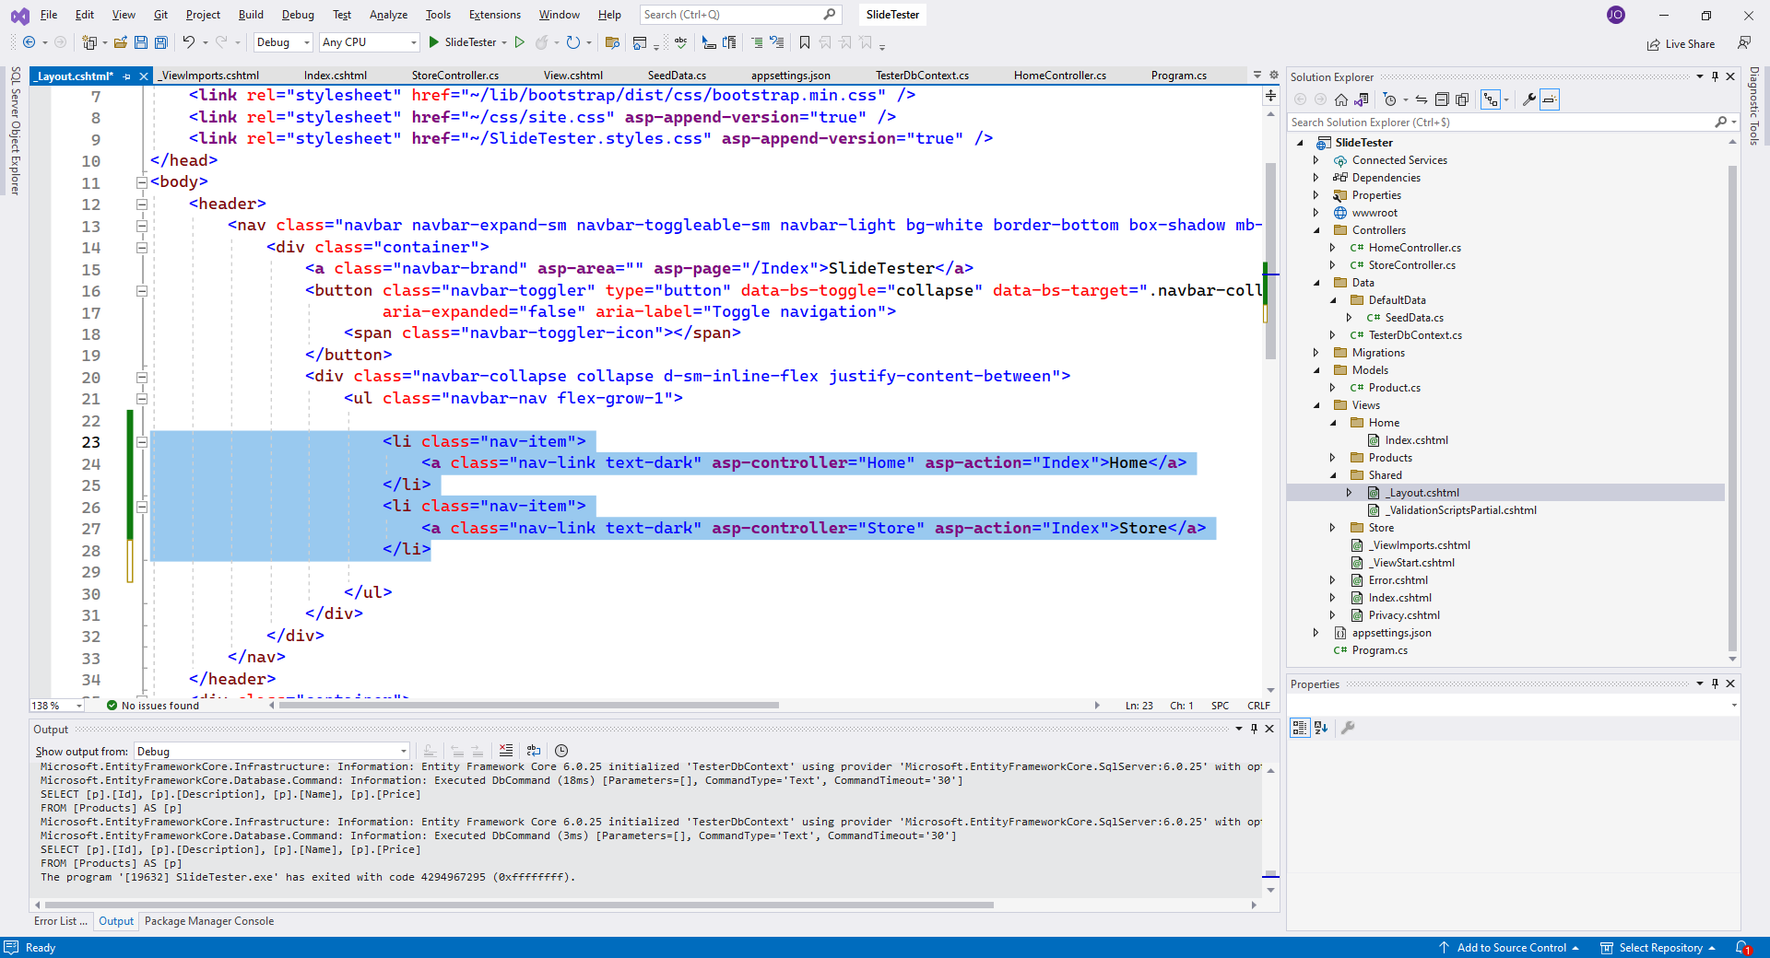
Shared
Wa alter the navigation to use ‘asp-controller and asp-action

